Slide 1




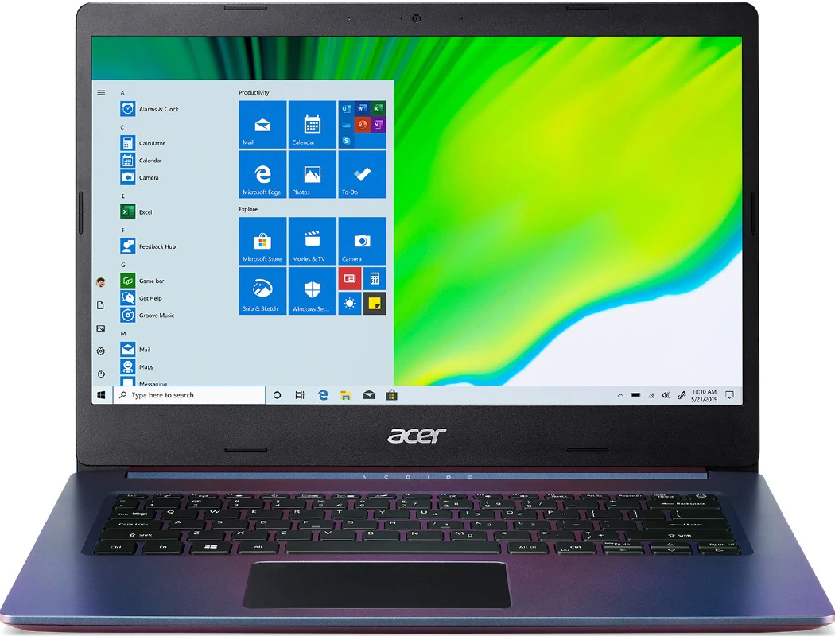
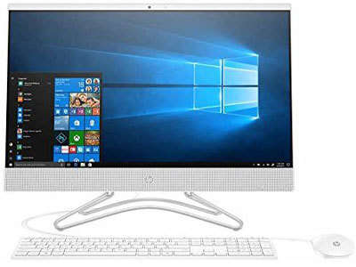
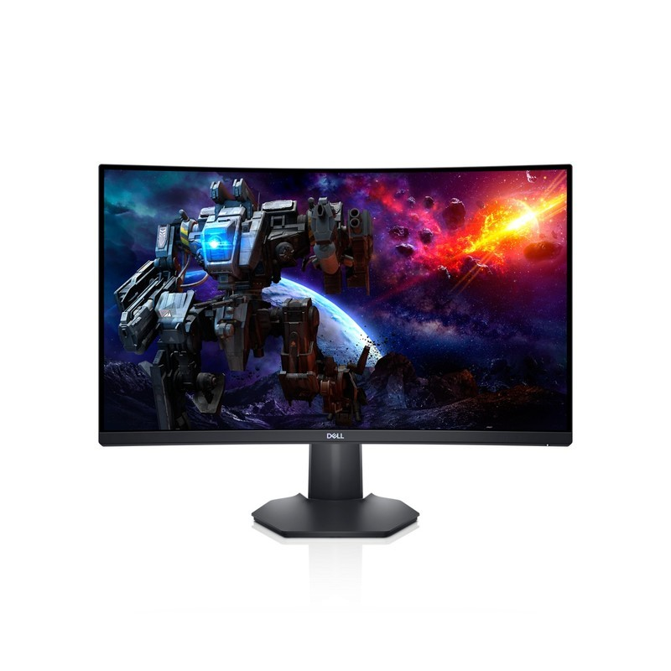
Call Us
8-6536-789
View Cart
News
Laptops
Computers
Monitors
Parts
Locations
Email Us
Contact Us
Categories
Laptops and Computers
accessories
Computers
laptops
Monitors
New arrivals
Parts for pcs & laptops
Printers
Networking
Acer Laptops
HP Computers
Dell Monitor
Speakers
Discount Electronics has the lowest laptop prices.
Order Computers for low prices.
Build up your personal computers with high quality monitors.
Tablets
Telecom
Laptops
Computers
Monitors
Cables and wires

